Slide 1
Lab - Node.js

Slide 2
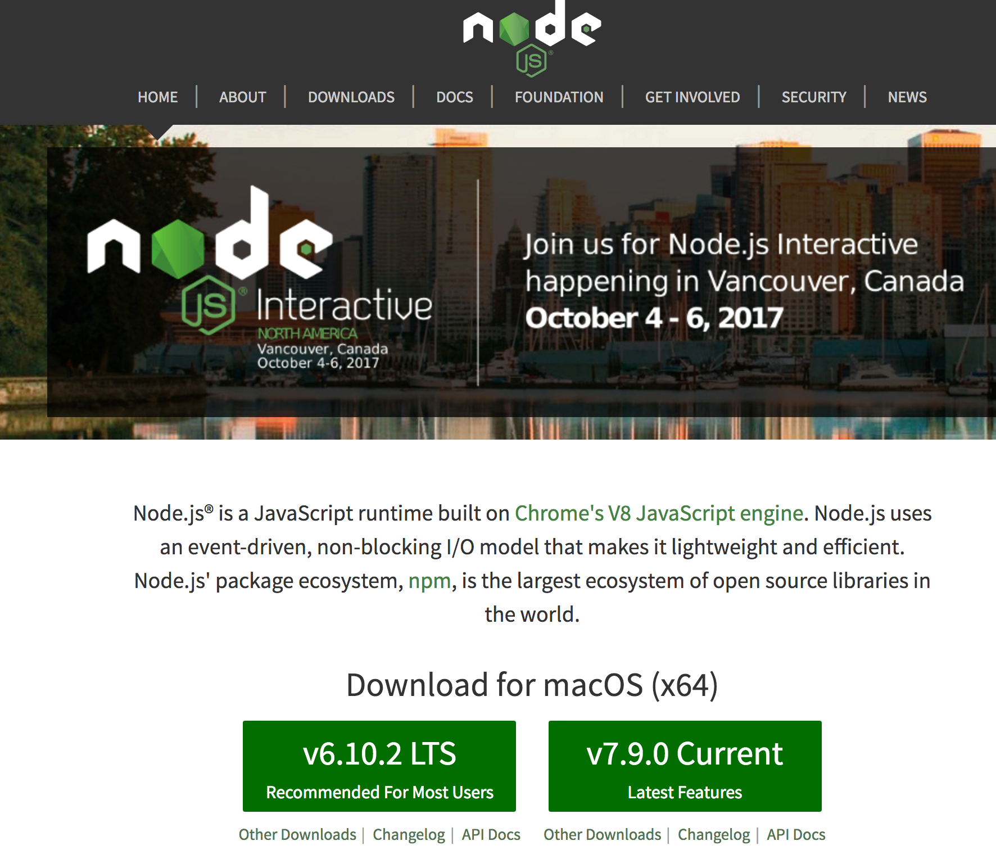
Node.js installation

Slide 3
Simple Web Server - Import to Apigee Edge
Step 1
Open the Edge UI in your browser.
Step 2
Click APIs, then click + API Proxy to create a new API.
Step 3
Select the Node.js App in the Build a Proxy screen and then click Next.
Step 4
Enter a proxy name hello_node and proxy base path /hello_node.
For the Source, make sure to select the “Hello World sample” option.
Click Next
Step 5
On the Security screen, select Pass through (none). Click Next

Slide 4
Simple Web Server - Import to Apigee Edge
Step 6
On the Virtual Host screen, leave the default options selected. Click Next.
On the Build screen leave the default options selected. Click Next.
Step 7
Open a browser and enter http://{yourorg-env}.apigee.net/hello_node
You should receive the response Hello World.
Next Step
Modify the app.js Node code as per the next slide

Slide 5
Simple Web Server - v1
var express = require('express'); var app = express();
app.get('/', function(req, res){ res.send('hello world'); }); app.get('/hello', function(req, res) { var responseObj = {}; responseObj.message = "Hello from Express"; res.json(responseObj); }); app.listen(9000);

Slide 6
Simple Web Server - v2
Add the below code to your Node.js application:
var request = require('request');
app.get('/stores/:storename', function(req, res) { const options = { url: 'https://apibaas-trial.apigee.net/ssvaidyanathan/labs01/stores/'+ req.params.storename, method: 'GET', headers: { 'Accept': 'application/json' } };

Slide 7
Simple Web Server - v2 - contd..
Add the below code to your Node.js application:
request(options, function(err, response, body) { var json = JSON.parse(body); console.log(JSON.stringify(json)); res.json(json); }); });

Slide 8
Test
Save the node proxy
Test by navigating to:
http://{yourorg}-test.apigee.net/hello_node/stores/Shop 3

Slide 9
THANK YOU

